Slide 1
Dashboard in a Day
<instructor>

Slide 2


Prerequisites and setup steps
At minimum, a computer with 2-cores and 4GB RAM running Windows 7 / Windows Server 2008 R2, or later
Display: At least 1440x900 or 1600x900 (16:9) recommended.
Internet connectivity: You must have the ability to connect to the Internet outside your organization
Microsoft Power BI Desktop installed: you should have downloaded and installed Power BI Desktop from https://go.microsoft.com/fwlink/?LinkId=521662. Optionally, you can also install Power BI Desktop from the Power BI Desktop Install folder on the flash drive that will be provided today.
Microsoft Power BI Desktop requires Internet Explorer 9 or later.
Signup for Power BI: Go to http://aka.ms/pbidiadtraining and sign up for Power BI with a business email address. If you cannot sign up for Power BI, let the instructor know.
If you have an existing account, please go to http://app.powerbi.com and Sign in using your Power BI account

Slide 3
Agenda (times are approximate and will be fluid with the class)
Morning
09:00 AM – 09:30 AM – Introduction to Power BI and Power BI Desktop overview
09:30 AM – 1:00 PM – Power BI Desktop – Lab
1:00 PM – 1:30 PM – Lunch and demos
Afternoon
1:30 PM – 1:45 PM – Power BI Service overview
01:45 PM – 02:30 PM – Power BI service – Lab
02:30 PM – 04:30 PM – Bring your own data and build dashboards
04:30 PM – 05:00 PM – Q&A
Notes:
Key message: in this workshop we will cover the breath of Power BI capabilities.
After analyzing and visualizing the dataset provided in the workshop, you will use the these skills to get started on your own data.

Slide 4
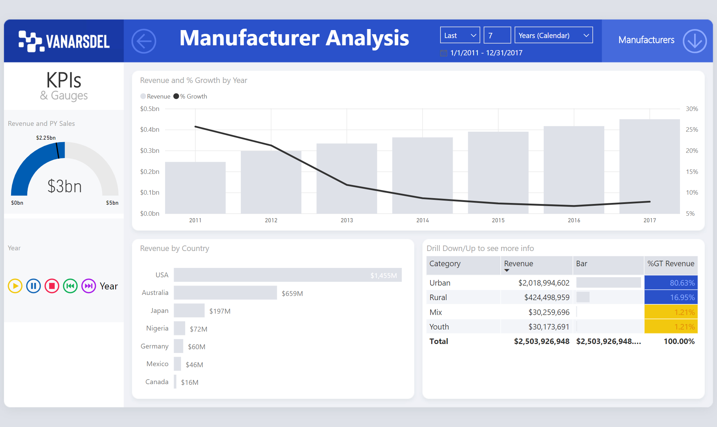
Dashboard in a Day
Notes:
Key message: Dashboard in a Day is a hands-on workshop for Business Analysts, covering the breadth of Power BI capabilities.
During the day attendees will be working to build a set of Reports and a Dashboard.
The view you see here is the end result that students will be building during the day

Slide 5
The Evolution of BI
3rd wave End user BI
Everyone
2nd wave Self-service BI
Analyst to end user
1st wave Corporate BI
IT to end user
Notes:
The way business intelligence is used in organization has changed significantly over the years. One way of understanding these changes is using the analogy of these three waves of BI:
In the early days of BI, organizations would typically have a team or person handling all the requests for insights from the business. This model is not very scalable, and it can take a long time for the answer to get back to the user. By the time it does, a new question probably has already come up.
To solve for this lack of scalability and gap between BI team and end users, the second approach to BI was to get BI capabilities in the hands of analysts, who understand the business and are able to support decisions with analytics.
With Power BI, we want to enable everyone in the organization to analyze their data, ask the questions will help them run their business better, and act based on the insights they find.

Slide 6
End User Needs
Access
Clean
Mash-up
Explore
Visualize
Share
Notes:
If we want to deliver on this vision then we need to start with the end user needs. It turns out that end users needs 6 things:
Access to data: the ability to easily connect to data that lives in different systems and locations
Clean data: The data does not usually come in the form that end users needs and a lot of time there are errors in the data. End users need an easy way to clean the data and model it in a format that is optimized for their reporting.
Mash-up data: Users need to combine data from multiple sources in order to produce the reports that they need. They need an easy way to connect data from multiple data sources and mash it up together
Explore: Then once they do all of this users need an easy way to explore that data, drill-down, slice and dice ,and find the insights and hidden trends in the data.
Visualize: Once they identify the insights they need to be able to Visualize that data so that is easy to share those insights with other users. As we usually say a picture is worth a 1000 words.
Share: Finally, they need an easy way to share these insights with others users
Once the data is shared with others, the same process starts again for that user, where he/she might want to add sources, look at the data form a different perspective, ask new or different questions.

Slide 7
Power BI: experience your data Any data, any way, anywhere
DATA
ACTION
INSIGHTS
Get started quickly
People
Cloud
Real-Time Dashboards & Interactive Reports
Natural Language Query
Custom Visualizations
Apps
On-premises
Power BI
Automation
PC
Mobile
HoloLens
Notes:
The explosion of data permeating all organizations is pivoting the way we interact with data and the way we seek to draw intelligence from this vast – and often untapped – potential.
Consider that by 2020 there will be 50 zetabytes of data – this is 20,000 times the total amount of data that existed in the world less than three decades before.
And for most organizations, this data often resides on-premise, in the Microsoft cloud or another – such as Office 365, Dynamics 365, Salesforce, Marketo and others. Or it may reside in both the cloud and on-premise [i.e. hybrid]…making it challenging to access and draw actionable insights from the data.
With Power BI there’s no need to move your data; we’ll meet you where you are…as a business intelligence and analytics SaaS service, Power BI equips business users to directly connect with and gain insights from their business data.
Harness data from Excel spreadsheets, on-premises data sources, big data, streaming data, and cloud services – it doesn’t matter what type of data you want or where it lives, Power BI allows you to connect to hundreds of data sources.
We’ve developed content packs that deliver a curated experience with pre-built dashboards for popular SaaS services to get you up and running quickly.
And Power BI delivers unmatched, unique ways for users to experience their data with speed and agility:
Live dashboards that maintain a real time pulse on the business and provide critical insights…
Custom visuals that bring data to life and surface intelligence hidden in the sea of data…
Natural language query that enables uses to simply ask questions of their data in an intuitive way…
Whether in the office or on-the-go, Power BI also provides anywhere access to insights with dashboards accessible via the desktop, web or across mobile devices.
Perhaps most importantly, with Power BI you can leverage world-class data analytics capabilities from historical data sets, but it also delivers the ability to see your data as it’s happening right now…no longer looking in the rear-view mirror.
The notion of transitioning from historical intelligence, to real time insights and ultimately to enable action is propelling modern BI and accelerating the evolution of Power BI…
This means equipping users to take action where and when needed…
For example, Power BI seamlessly integrates with Microsoft business apps like Dynamics 365 and Office 365, equipping users with insight directly within the Microsoft apps they use every day. And with Power BI Embedded, organizations also have the flexibility to infuse third party apps with the same intelligence…
Lastly, integrating intelligence at the point of action leads to automation within systems that trigger commands based on preset thresholds…further operationalizing business insight throughout an organization.

Slide 8
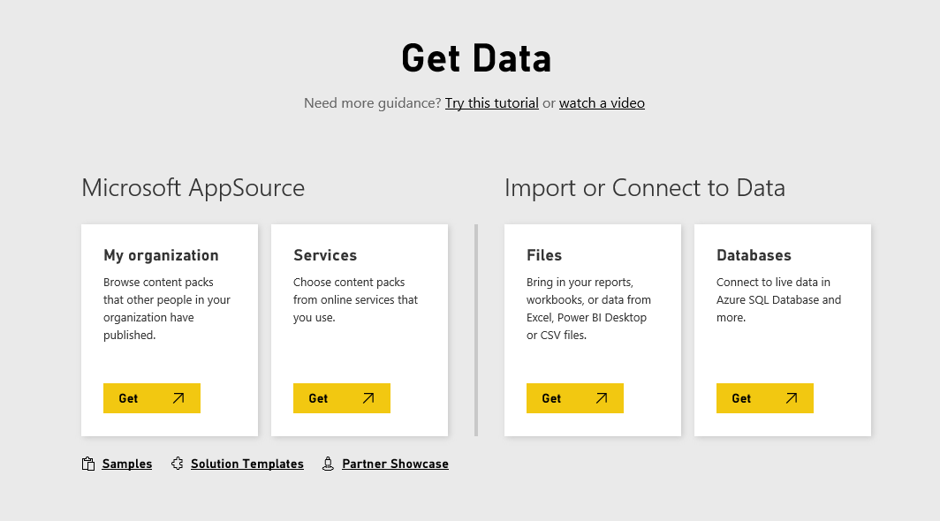
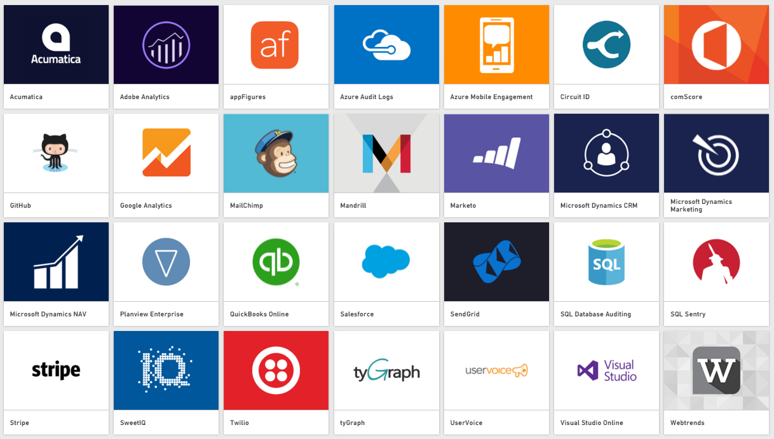

Data sources
Access all your DATA
SaaS solutions
e.g. Marketo, Salesforce, GitHub, Google Analytics
Data from services
SaaS services that you already use
Growing number of supported SaaS solutions
Data from your organization
Content published by others in your org (organizational content packs)
Big data and more
Azure data services, e.g. HDI, ASA, AML etc.
On-premises data sources, e.g. SSAS
Data from files
Import data from Text, CSV, Excel and Power BI Desktop files
Organizational Corporate data sources or external data services
On-premises Data
Azure services
Azure SQL, Stream Analytics…
Excel files
Power BI Desktop files
Data from files, databases, Azure, and other sources
Notes:
Key message:
Power BI connects to a variety of data sources, enabling you to view and explore data from hybrid sources in a single location.
Talking points:
The Power BI Get Data feature lets you quickly and easily connect to all of your data
This includes a range of both cloud sources, on premises sources and specific data files —from the SaaS solutions you already use to your organization’s on-premises data
Many sources have been integrated with Power BI, connecting in minutes with pre-built dashboards and reports
For the first time, you can easily get a consolidated view of your data, no matter where the data actually lives

Slide 9
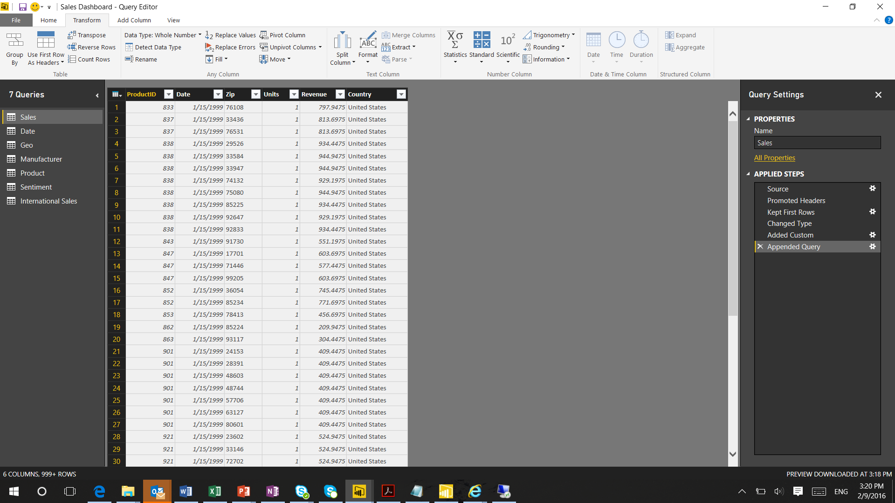
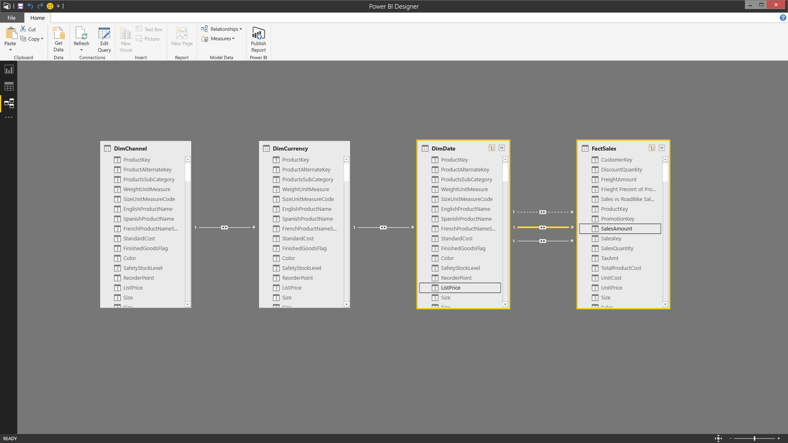
Clean and mash-up your DATA
Consolidate data from a broad range of sources
Merge or append queries to combine data from multiple queries into a single query
Transform data to fit your needs using intuitive UI
Select data for inclusion
Cleanse data and remove errors
Define calculations to generate new fields for use in reports
Develop advanced analytics using a combination of measures and relationships
Uncover correlations, highlight exceptions and understand business outcomes
Prepare
Explore
Visualize
Share &
collaborate
Notes:
We provide powerful capabilities that allow users to shape, transform, and clean this data for analysis. Data is rarely in the right format for analysis and a self-service business analysis tool must provide the flexibility to transform and clean data before it can be properly analyzed. We provide these capabilities as an integrated part of the data preparation experience, providing a more flexible, and ultimately a faster, experience for business analysts to work with data and build reports.
We provide one of the industries leading modeling experiences, for joining this data from multiple data sources together across different types and sources, for analysis and for creation of custom calculations and measures. We provide business analyst with a complete range of modeling capabilities.
Power BI Desktop enables extensive data analysis, enabling you to produce rich data models using formulas and relationships
Automatically create a model simply by importing data
Power BI Desktop detects relationships automatically, categorizes data and applies default summarization
Refine models to enable complex calculations
Identify relationships between datasets from a variety of sources
Create relationships between tables manually or using the AutoDetect feature
Desktop’s AutoDetect feature accelerates your analysis
Adjust relationship type (one-to-one, many-to-many or many-to-one) and cross-filter data for specific insights
Define calculations – known as measures – to generate new fields for use in reports. Measures create new information from existing data already in your model
Measures are used in some of the most common data analysis; for example, sums, averages, minimum or maximum values, counts, or more advanced calculations you create yourself using a DAX formula.
The calculated results of measures are always changing in response to your interaction with your reports, allowing for fast and dynamic ad-hoc data exploration
You can use automatically generated measures, or create custom measures with Data Analysis Expressions (DAX) formulas
This helps you enrich your data model
Produce exactly the results you need using the DAX library of 200+ formula elements
Use DAX library to create calculated tables too…
Develop advanced analytics using a combination of measures and relationships
Uncover correlations, highlight exceptions and understand business outcomes

Slide 10
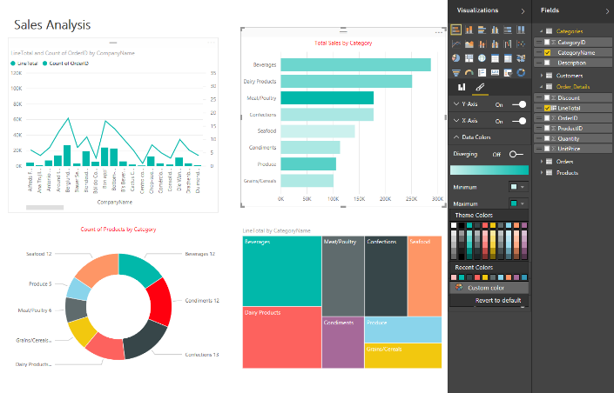
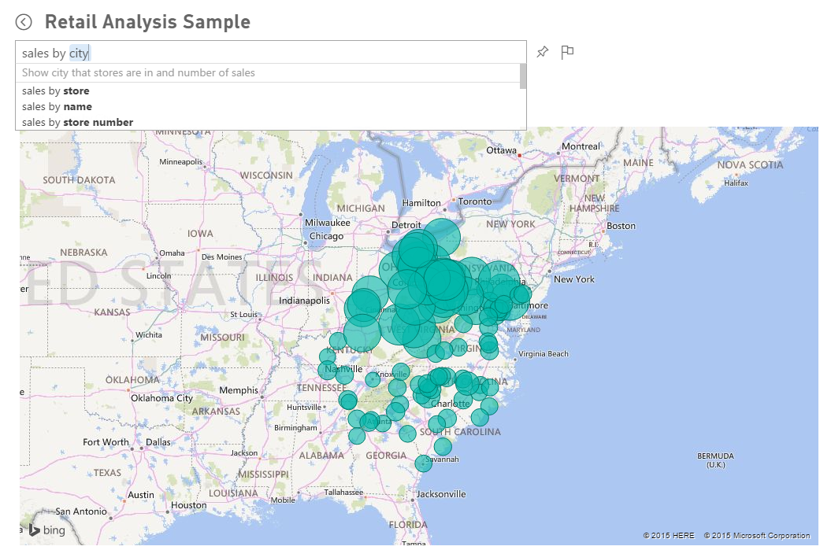
Explore your DATA
Explore data in a variety of ways and across multiple visualizations using drag and drop canvas
Dig deeper into your reports
Drill-down in your hierarchical data
Filter, sort, hover over and highlight data
Leverage Quick Insights to find insights in your data
Ask questions of your data in natural language with Q&A
Type questions in plain language
Q&A intelligently filters, sorts, aggregates, groups and displays data based on the question
Prepare
Explore
Visualize
Share &
collaborate
Notes:
Explore data in a variety of ways and across multiple visualizations
Select data elements and sort data
Filter data, leveraging cross-filter capability
Drill into and across datasets
Pivot and slice data
Change visualization types
Quick Insights - providing a new ways to help users find hidden insights in their data. The new Quick Insights feature allows users to automatically scan and detect patterns and trends in the data that they publish to Power BI. Through a partnership with Microsoft Research, the Quick Insights feature uses a growing list of algorithms to automatically discover and visualize correlations, outliers, trends, seasonality, change points in trends, and other factors in your data in seconds.
Natural Language Interface - With Power BI we continue to find new ways to simplify how people analyze and gain insight from data, providing industry leading features such as natural language query. Natural language query provides users with an easier way to interact with their data, allowing them to type questions of their data and receive answers in the form of live visualizations.

Slide 11
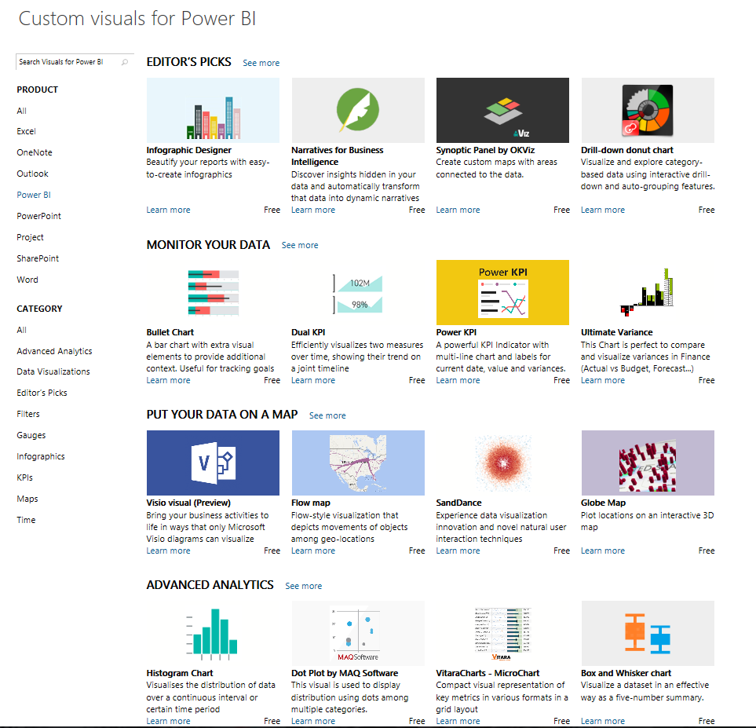
Visualize your DATA
Visualize data in a variety of ways
Growing number of visualization types
Donuts, basic area, waterfall, filled maps, tree maps, funnel, gauges combo charts and more
Custom visuals available from Power BI Visuals Gallery (https://store.office.com/en-us/appshome.aspx?productgroup=PowerBI)
Tools to develop, test, package new custom visuals
Visualizations on report page are connected – select value in one visualization to change other visualizations
Full screen pop out mode for report visuals to show additional details
Prepare
Explore
Visualize
Share &
collaborate
Notes:
You can experiment with visualizing data in different ways, enabling previously inaccessible business insights
Select from a growing number of visualization types different chart types
Use visualizations that go beyond standard charts – such as slicers, maps, tiles, stand alone images and others
Cross-filter across visualizations within a report to surface new insights
We’re also enabling developers to easily add custom visuals into Power BI for use in dashboard, reports and content packs. To help you get started, we’ve published the code for all of our visualizations to GitHub. Along with the visualization framework, we’ve provided our test suite and tooling to help the community build high quality custom visuals for Power BI. All of this is available as an open source project on GitHub. You can also visit www.powerbi.com/visuals to visit our community authored visuals gallery , download visuals and get started.

Slide 12
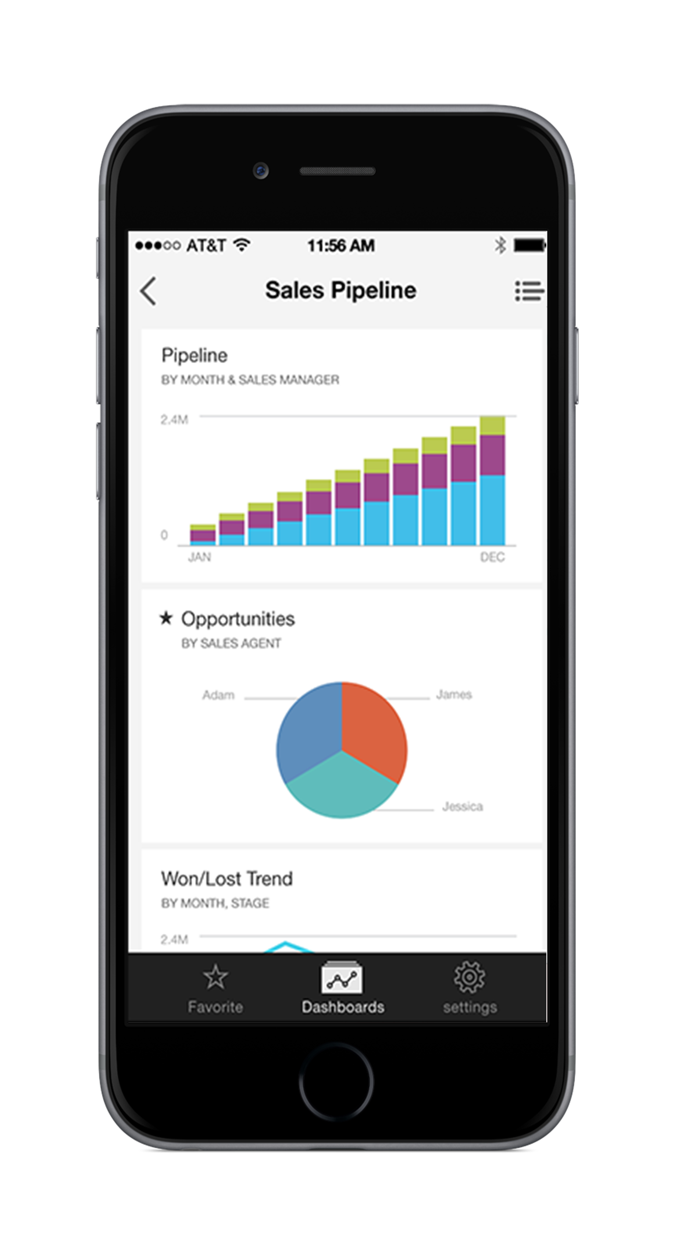
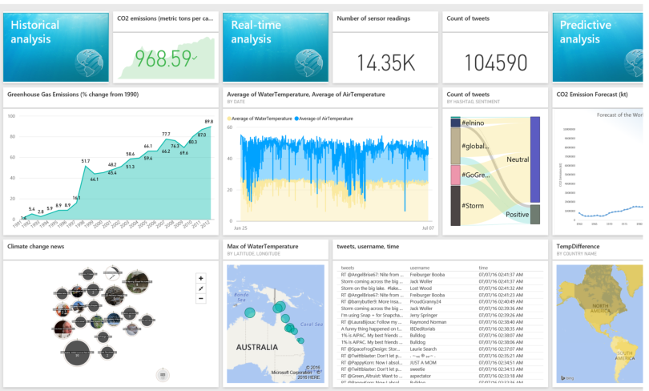
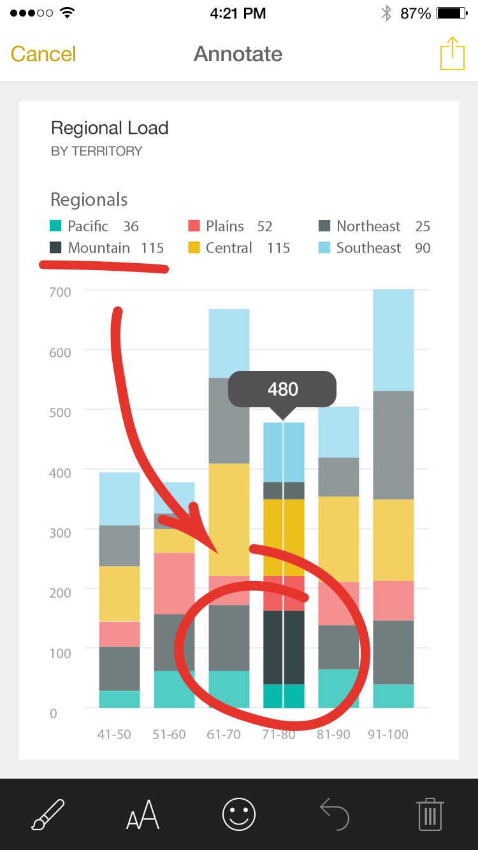
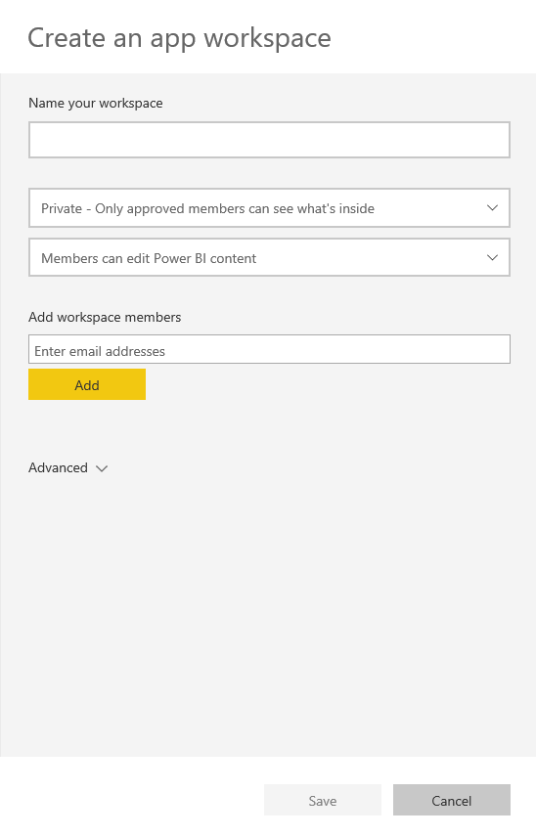
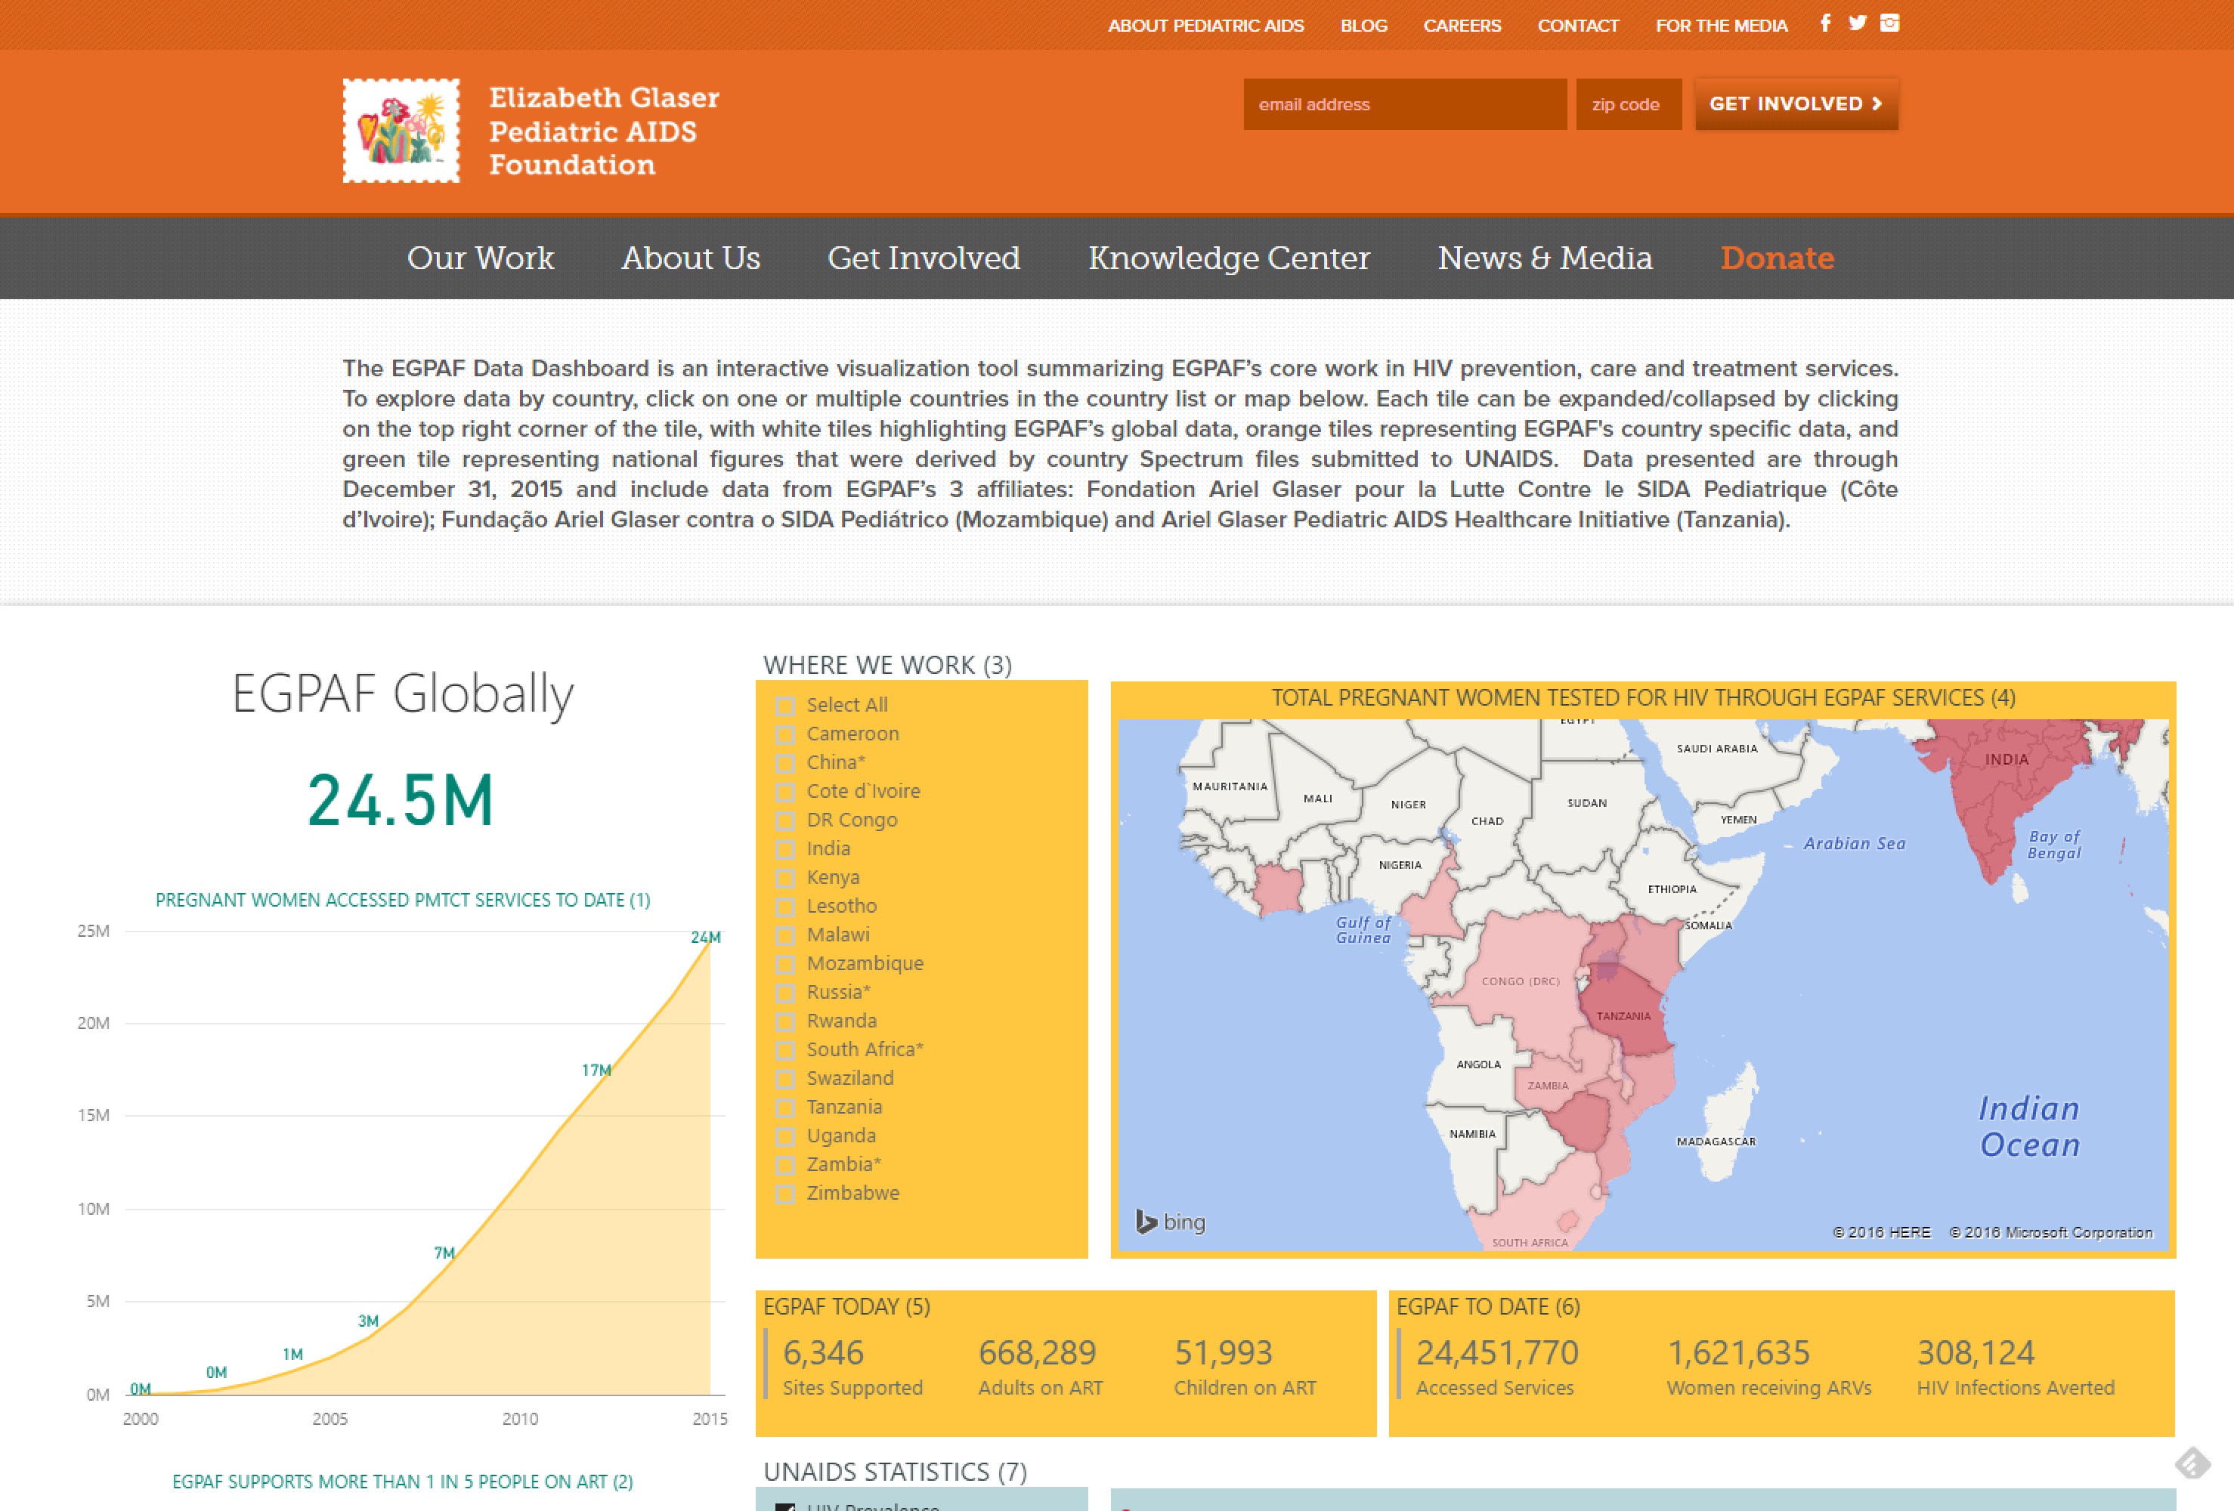
Bring your story to life with DATA
Save Power BI Desktop report files and easily publish them to powerbi.com
Access dashboards using native mobile apps for Windows, iOS and Android
Share as appropriate with other Power BI users in your organization
Publish Power BI apps to a broader set of people using Power BI Premium
Easily embed interactive Power BI visualizations in blog posts, websites, through emails or social media With Power BI Publish to web
Prepare
Explore
Visualize
Share &
collaborate
Notes:
Once you are ready to publish your report and the visualizations within it, you can surface it to a broader audience by publishing to the Power BI service
This enables you to give Power BI users access to richer data models and reports than they could create on their own
Cross-platform, native mobile apps. In addition to its rich Web client, there are native Windows, iPhone, iPad and Android apps that keep mobile users connected with their data, wherever they may be.
Team collaboration is enhanced with Power BI integrated with Office 365. Create Office 365 Groups so that only the members of the group can view and edit specific reports and dashboards. Navigate from Power BI to any of the other Office 365 workloads as you view conversations, documents, notes etc all in the context of your work group.
Power BI premium provides a flexible content distribution model, empowering a broader set of people with read access to critical intelligence without requiring per user licensing. To distribute content to these readers, a Pro user simply assigns workspaces to Premium capacity and publish Power BI apps to these workspaces. Readers throughout the organization can just consume these apps without having to have a per user license.
Finally one can embed Power BI visuals in websites and blogs for public anonymous access. This will allow enterprises to tell public facing data stories with ease .

Slide 13
REAL-TIME DASHBOARDS
Act & automate
NATURAL LANGUAGE
SOLUTIONS FROM MICROSOFT AND PARTNERS
INTEGRATION WITH EXCEL
custom visualizations
Notes:
Key message: What categorizes modern BI – cloud delivery – that is why we see the results in growth we are seeing.
Power BI is a modern BI solution and its cloud delivery enables us to innovate and execute at an incredible speed.
That’s why we’re seeing such exponential growth. That’s why we have over 5 million subscribers.
The ability to sign up in 5 seconds and get value out of data in 5 minutes or less, even as a non-technical user, has enabled that growth.
In many ways, we believe Power BI will change the way you work, empowering you and your organization to embrace a data-driven culture, giving you the ability to convert data into insights into action, as well as the ability to better collaborate with everyone across your organization.
Let’s take a look at some of the capabilities that set us apart:
Custom Visual: provide insights in the context of your business
Solutions from Microsoft and Partners: rapidly build a POC using your own data
Act & Automate: it’s not just about getting insights from your data (even though that’s a pretty big part) it’s about taking action on that insight, and even automating that action, leveraging PowerApps and Microsoft Flow
Real-time dashboards: live 360 view of your business so you can run it in real time instead of looking in the rearview mirror
Natural language: extract insights from your data without having to learn a complicated query language
Excel integration: you can pull data from Excel into Power BI, and you can take data from Power BI out to Excel, in a complete workflow

Slide 14
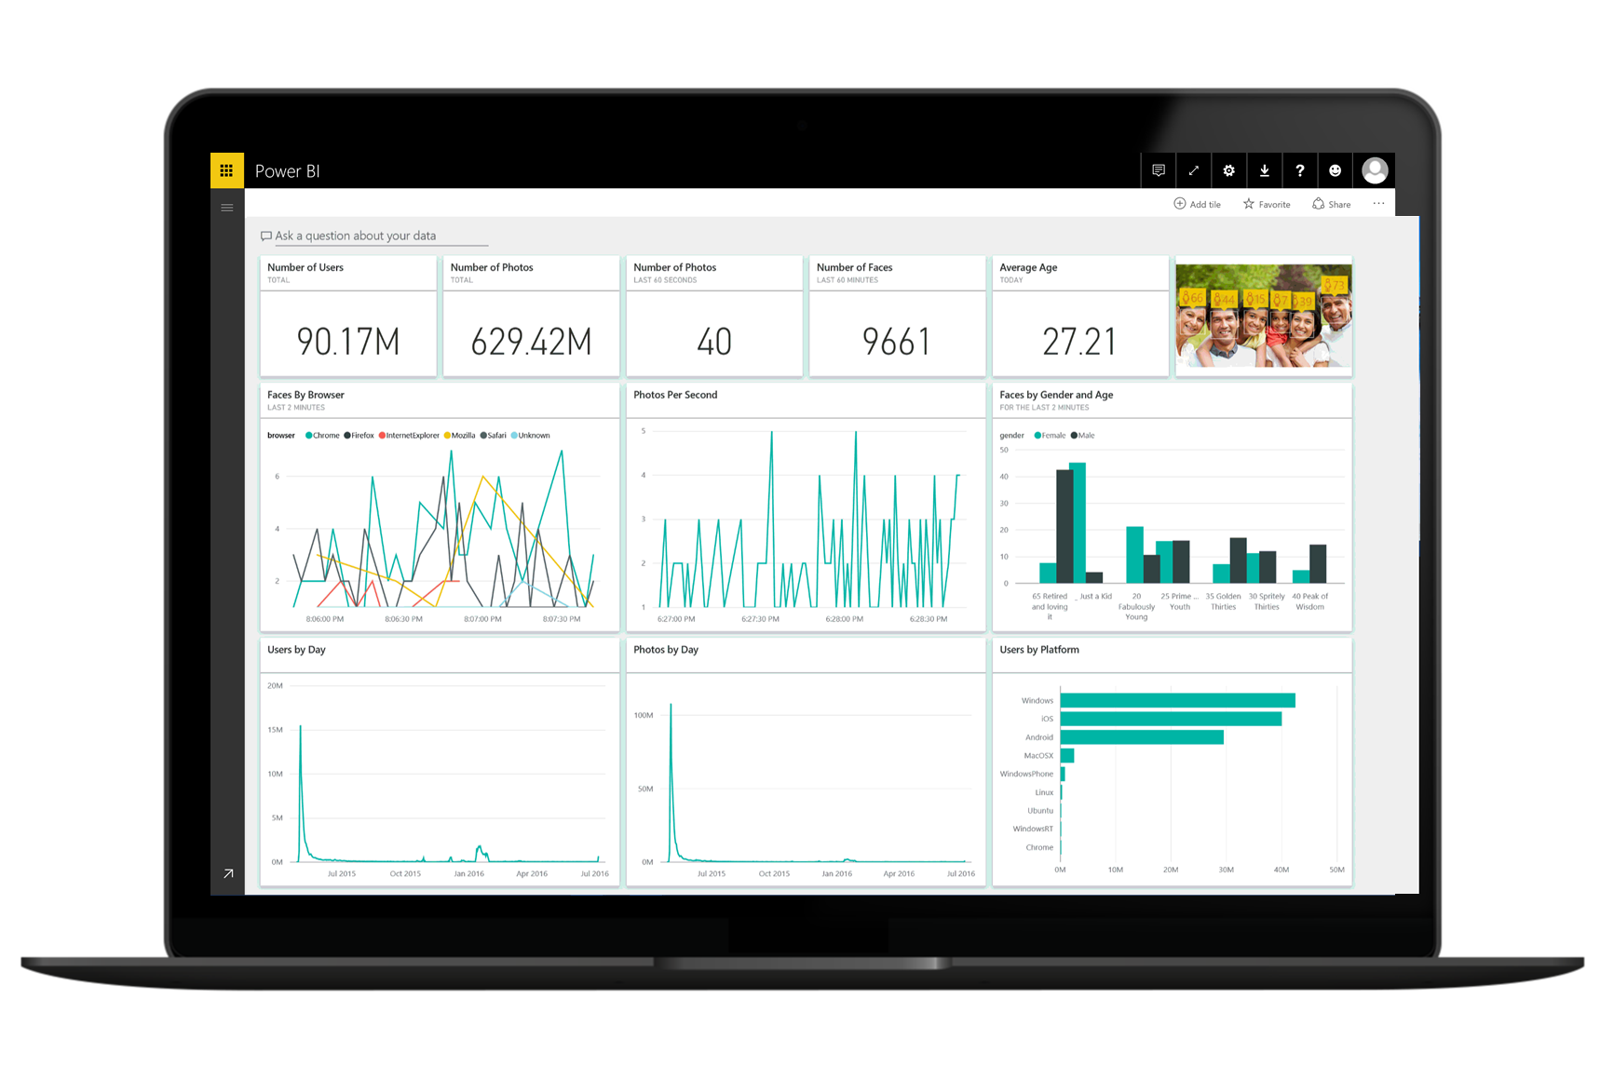
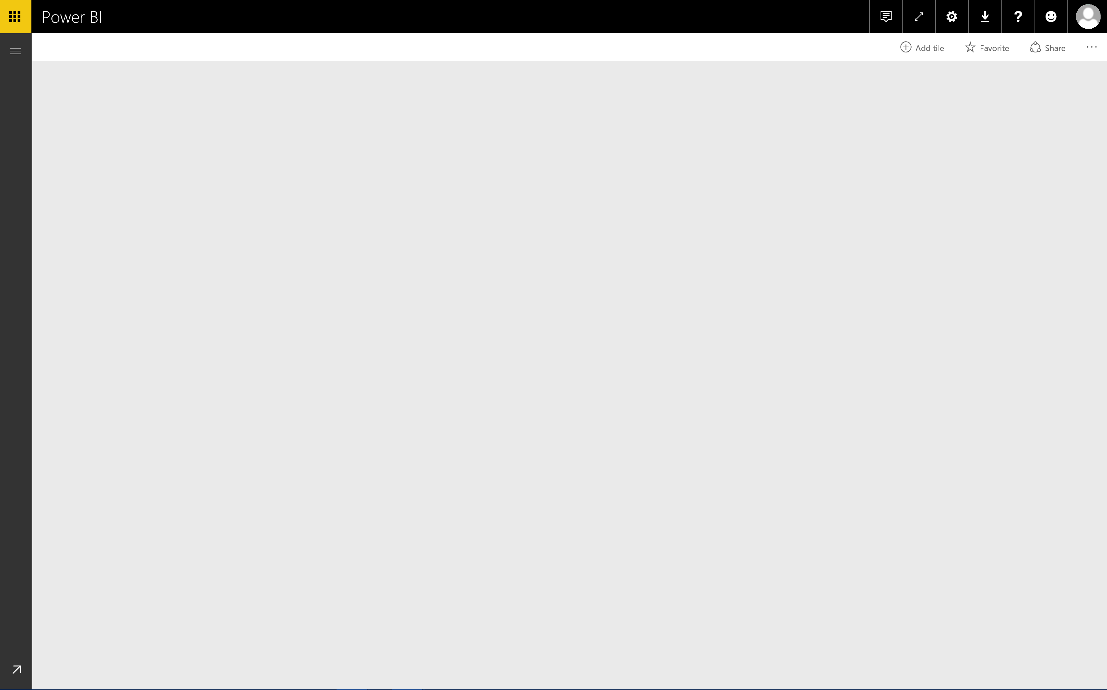
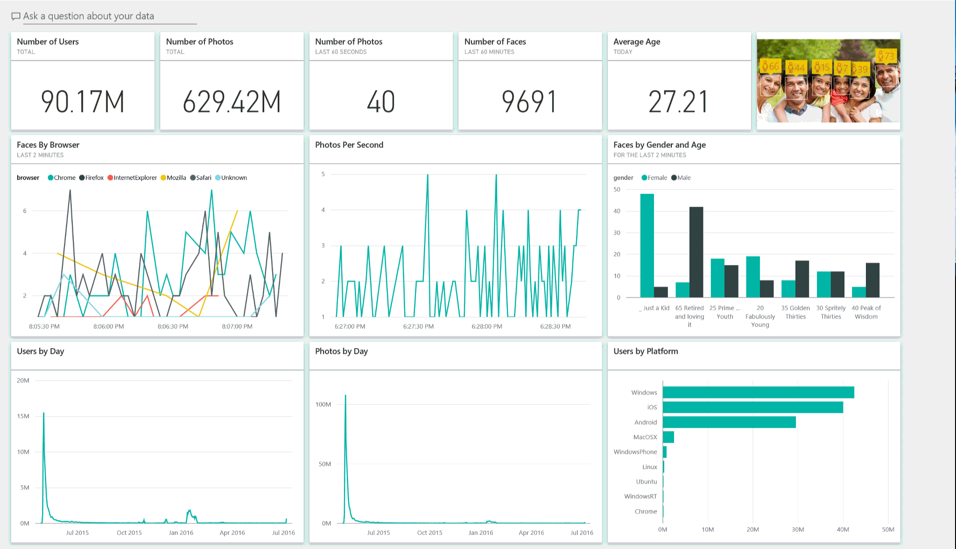
Run your business in real time with live dashboards
Notes:
Real-time dashboards: live 360 view of your business so you can run it in real time instead of looking in the rearview mirror

Slide 15
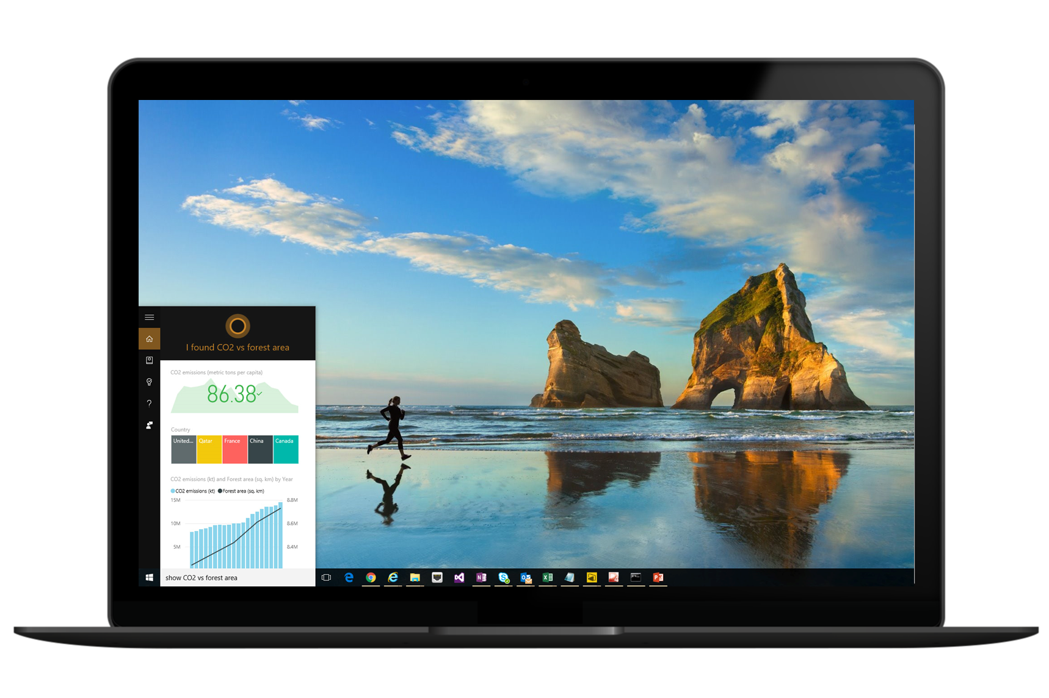
Ask questions of your data
Notes:
Natural Language Interface - With Power BI we continue to find new ways to simplify how people analyze and gain insight from data, providing industry leading features such as natural language query. Natural language query provides users with an easier way to interact with their data, allowing them to type questions of their data and receive answers in the form of live visualizations. Power BI integration with Cortana allows you to now ask these question directly from Cortana and to have answers from your Power BI data surfaced to you by Cortana. These data driven answers can range from simple numeric values (“revenue for the last quarter”), charts (“revenue over time”), maps (“revenue by region”) or data represented through any of the other Power BI data visualizations. Combined with the Cortana Analytics suite, this opens up amazing new opportunities to use Cortana to enable your business, and your customers' businesses, to get things done in more helpful, proactive, and natural ways.

Slide 16
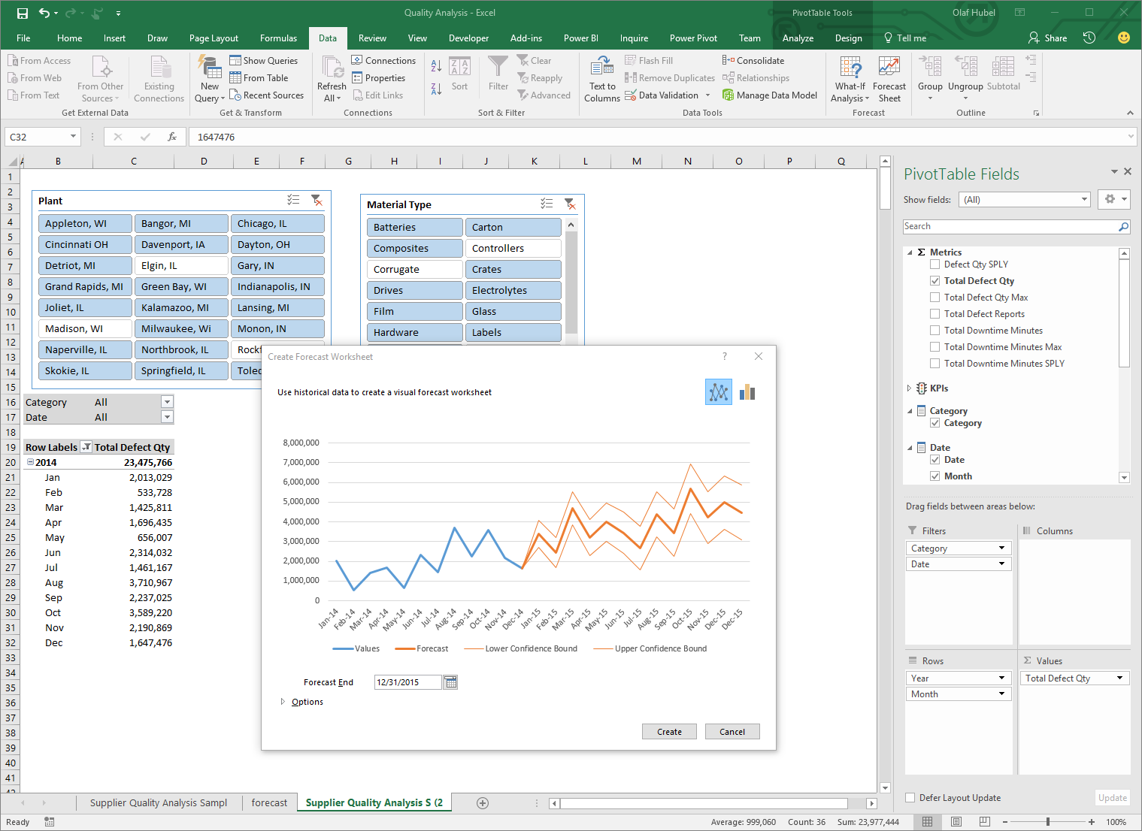
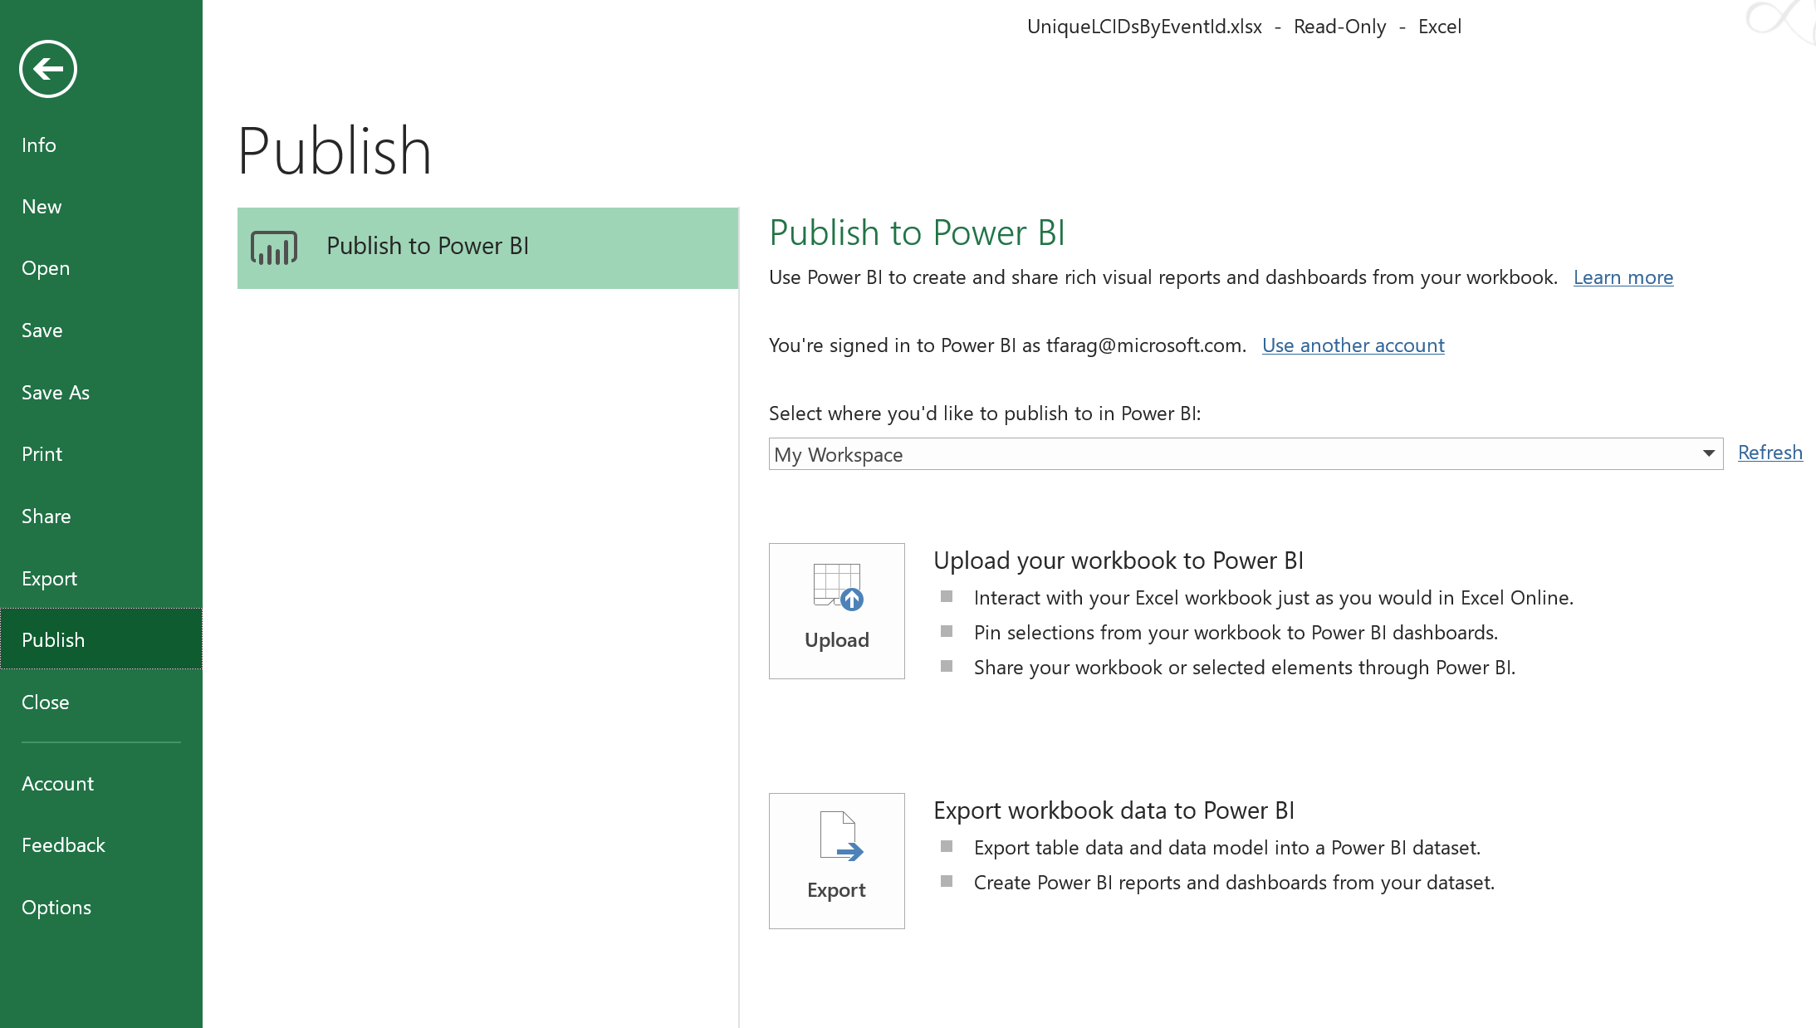
Deliver insights through deep integration with Excel
Notes:
Both Excel and Power BI Desktop are seamlessly integrated with the Power BI service. With a single click, these live spreadsheets and reports can be published and refreshed from the Power BI service for ease of access for business users across the organization.

Slide 17
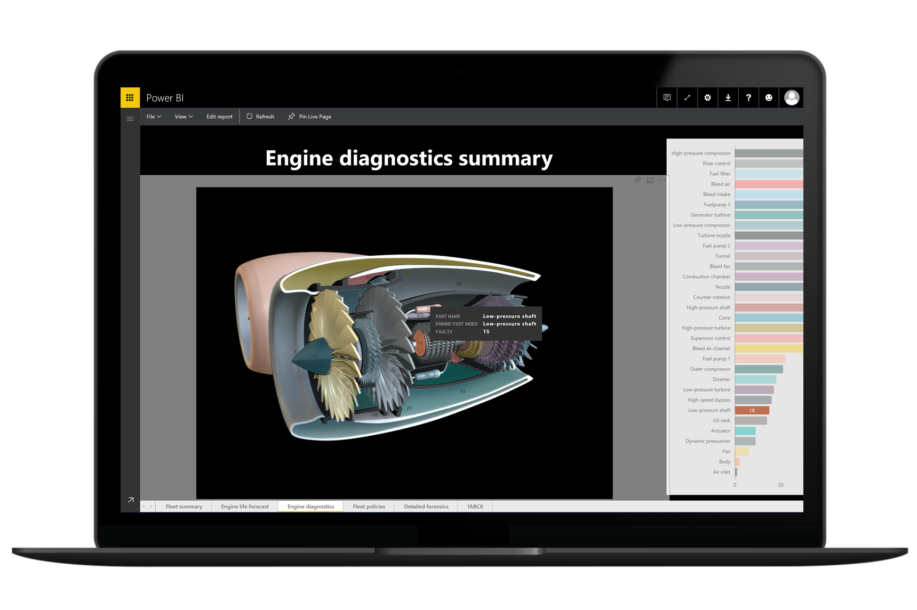
Visualize insights in the context of your business
Notes:
Custom Visual: provide insights in the context of your business

Slide 18

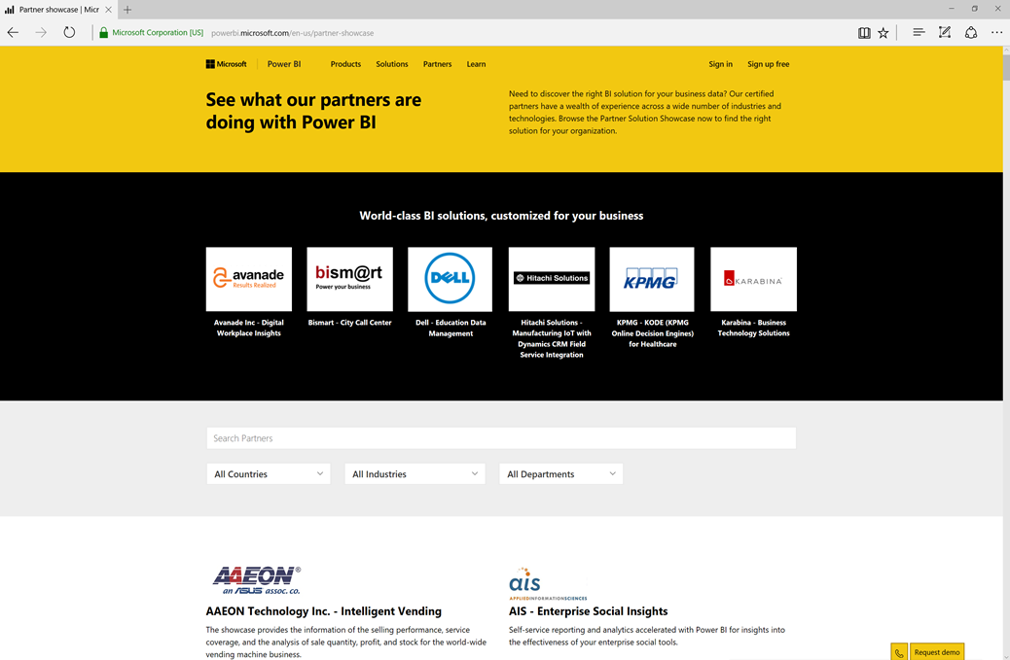
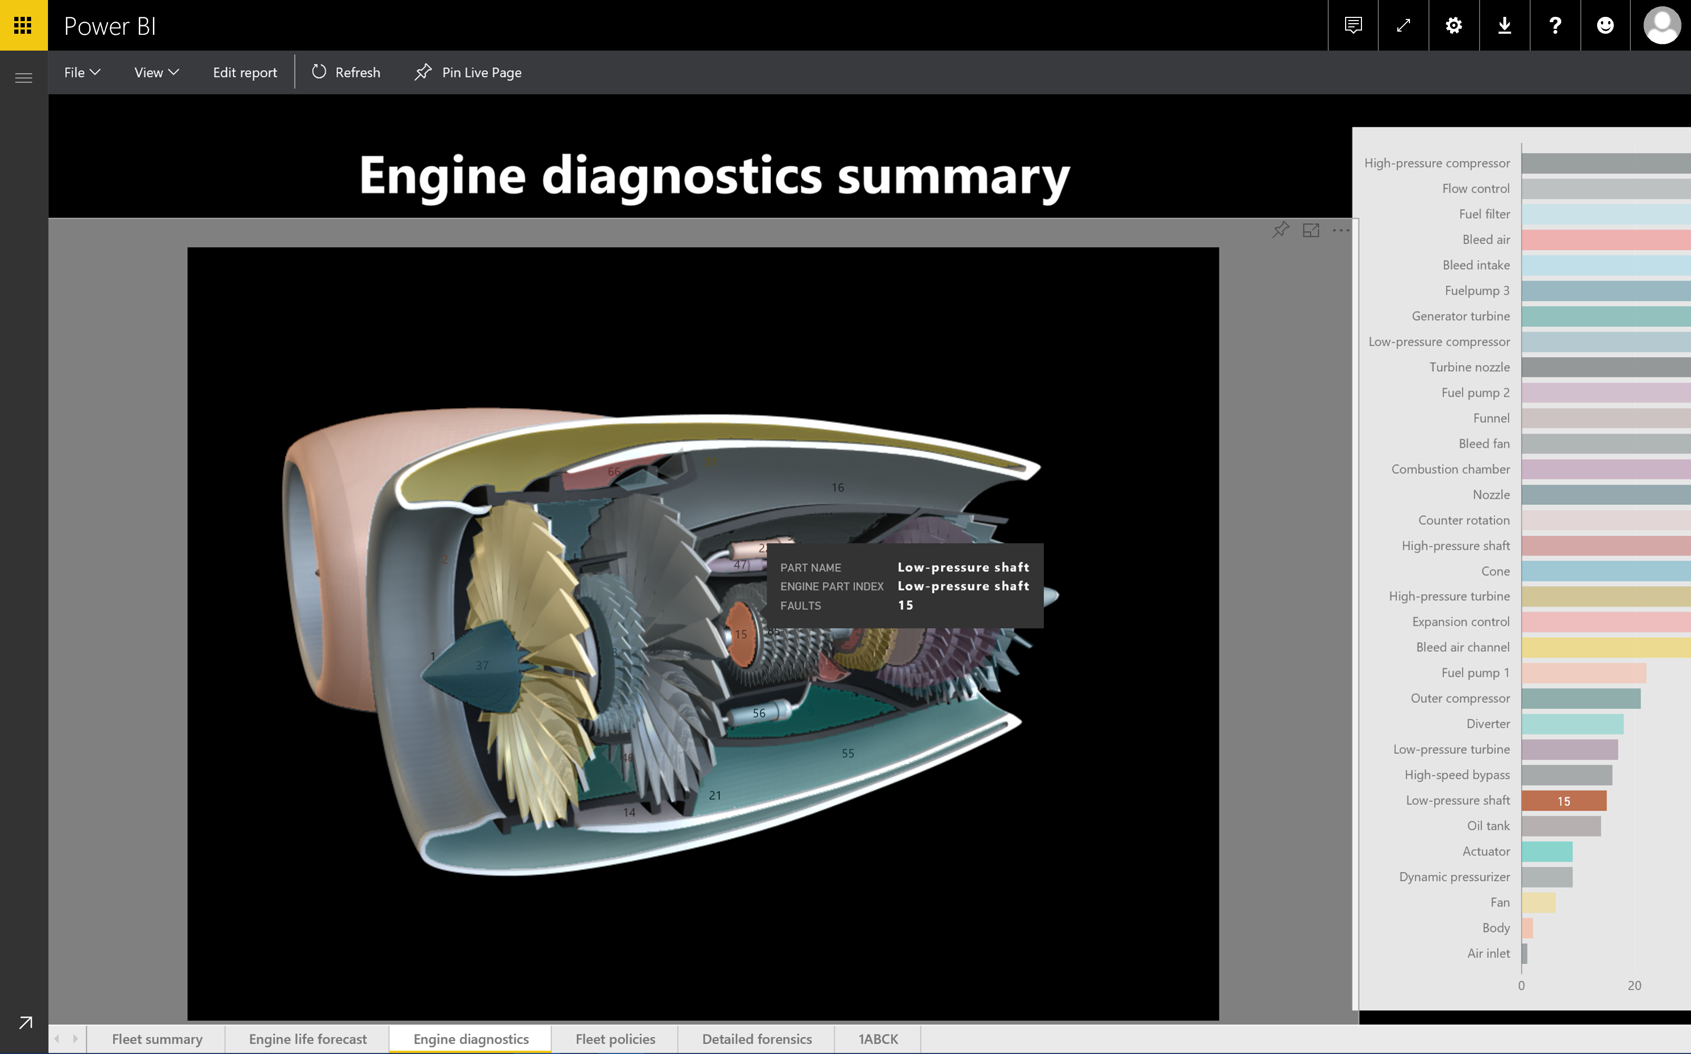
Accelerate deployment with Microsoft and Partner solutions
Notes:
Solutions from Microsoft and Partners: rapidly build a POC using your own data

Slide 19
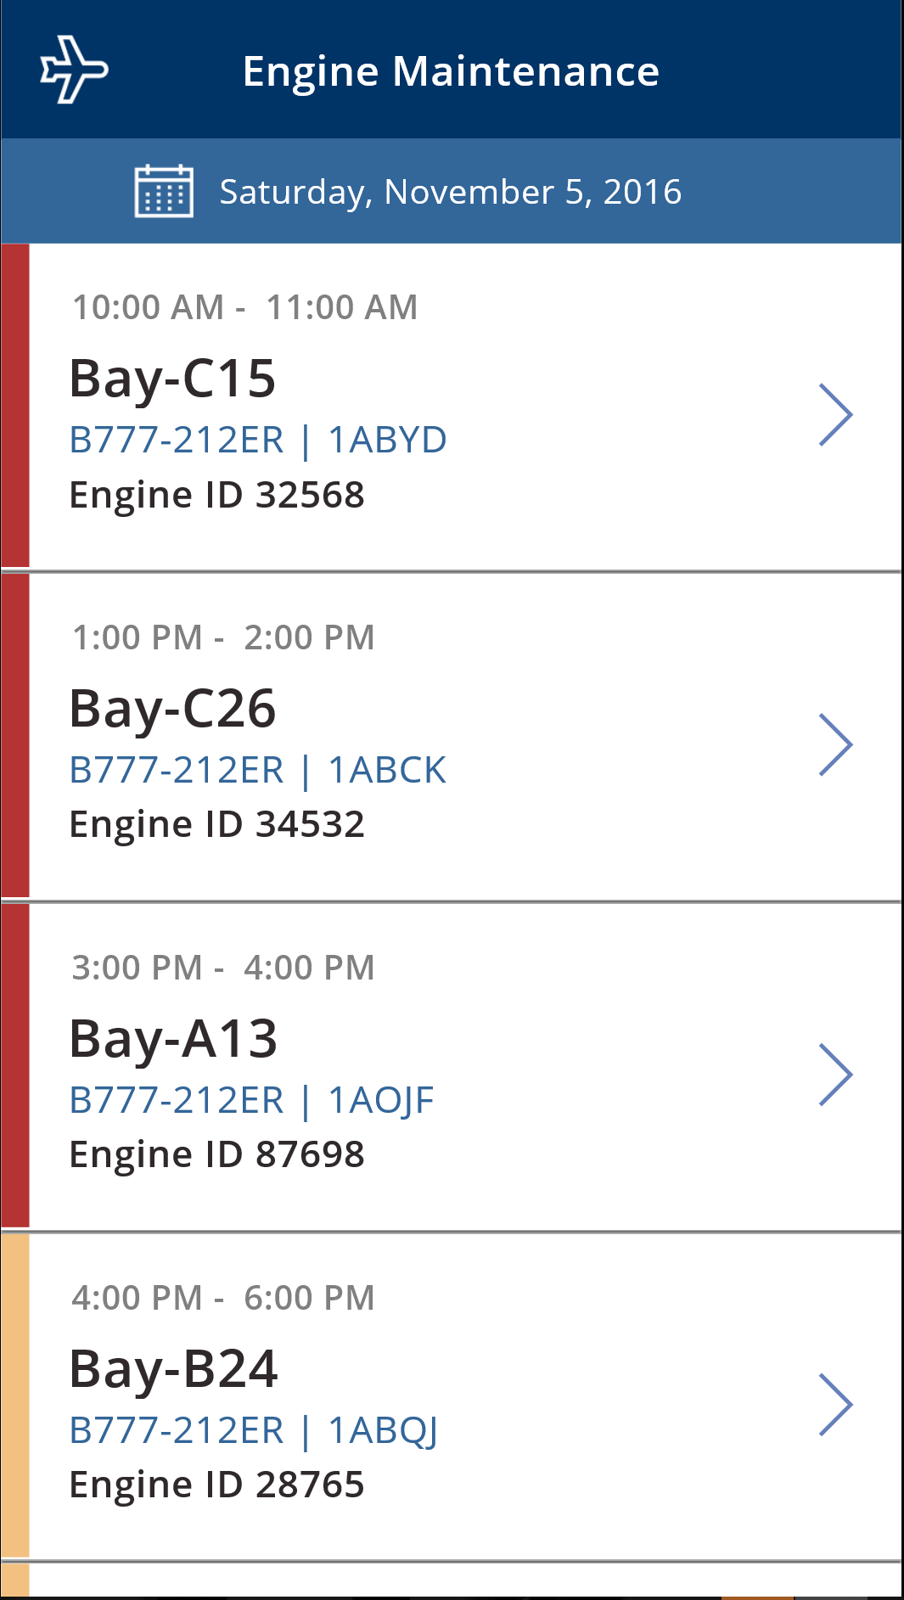
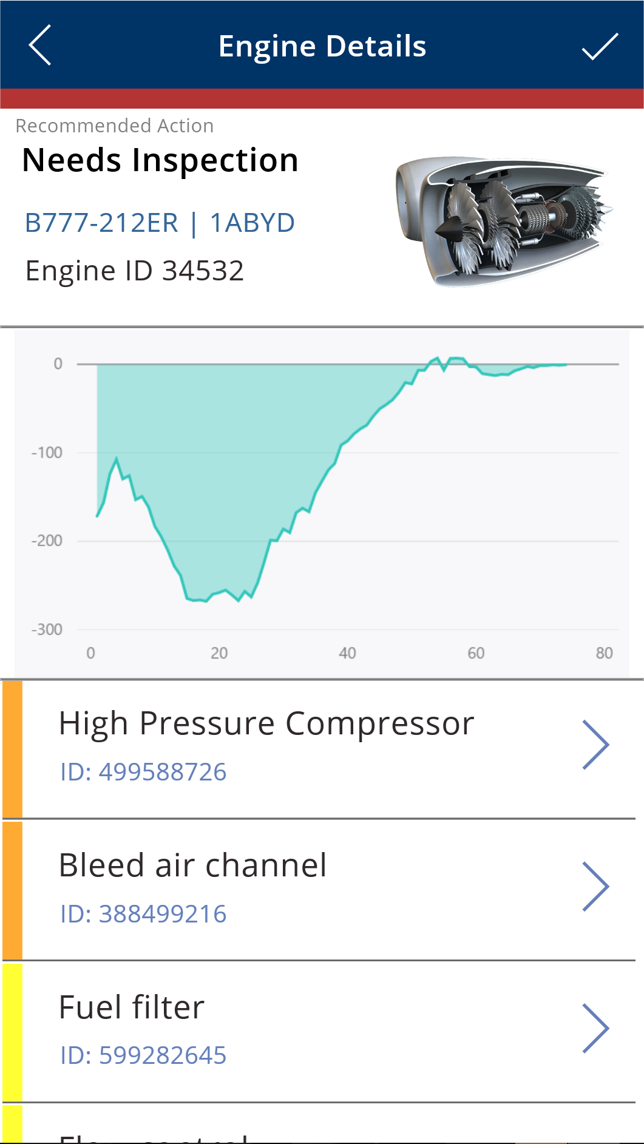
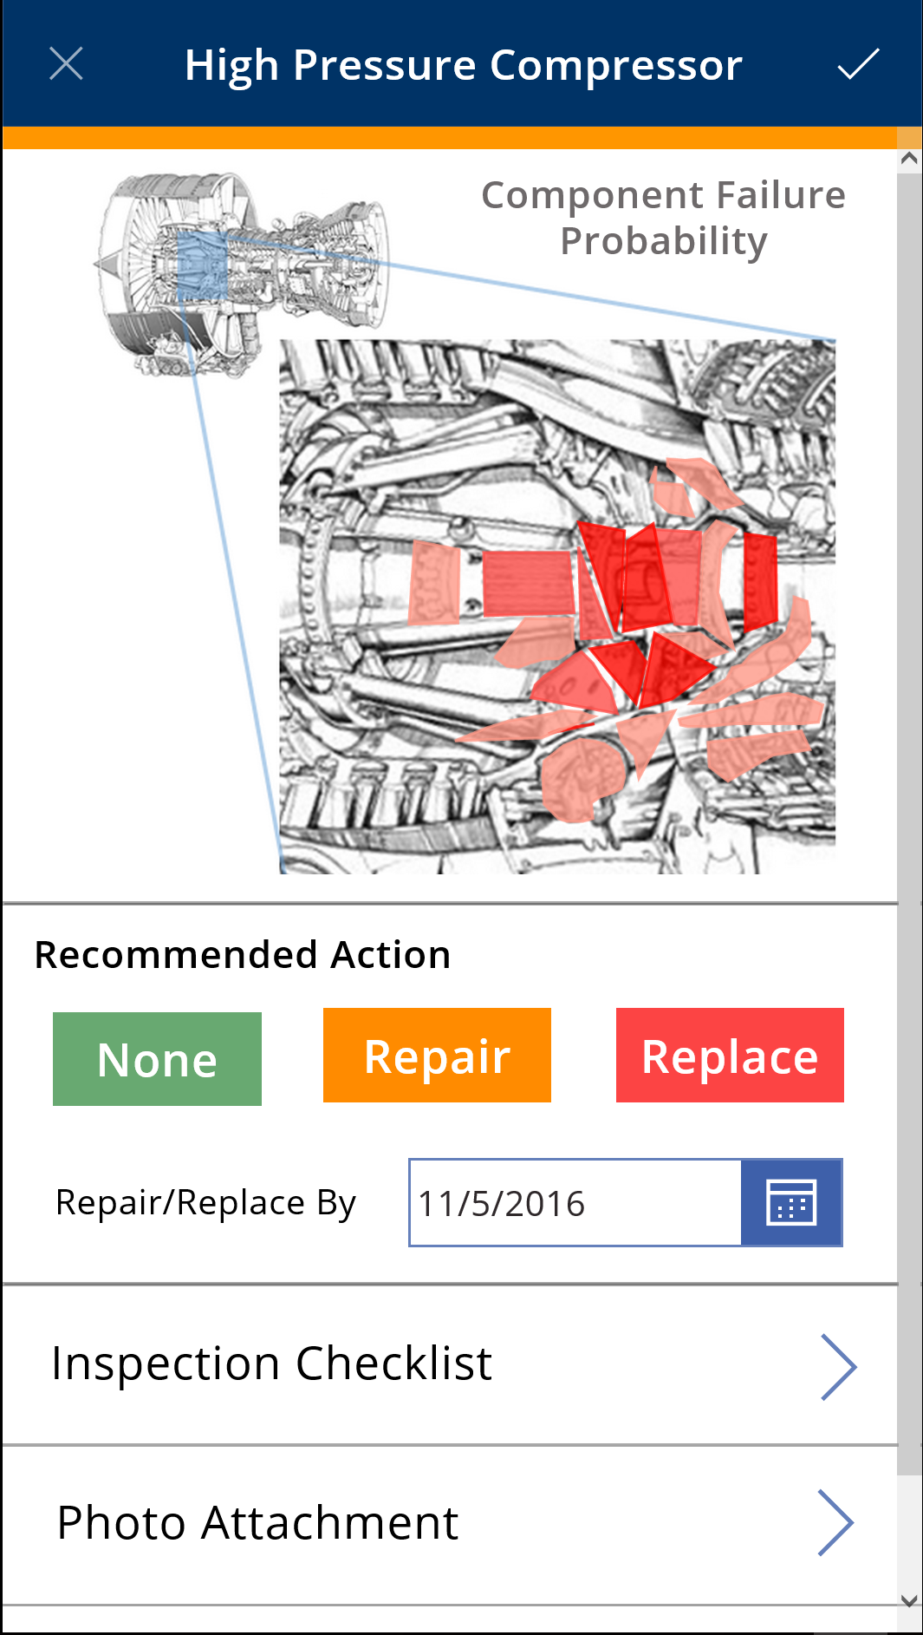
Get from insights to actions quickly
Notes:
Act & Automate: it’s not just about getting insights from your data (even though that’s a pretty big part) it’s about taking action on that insight, and even automating that action, leveraging PowerApps and Microsoft Flow

Slide 20


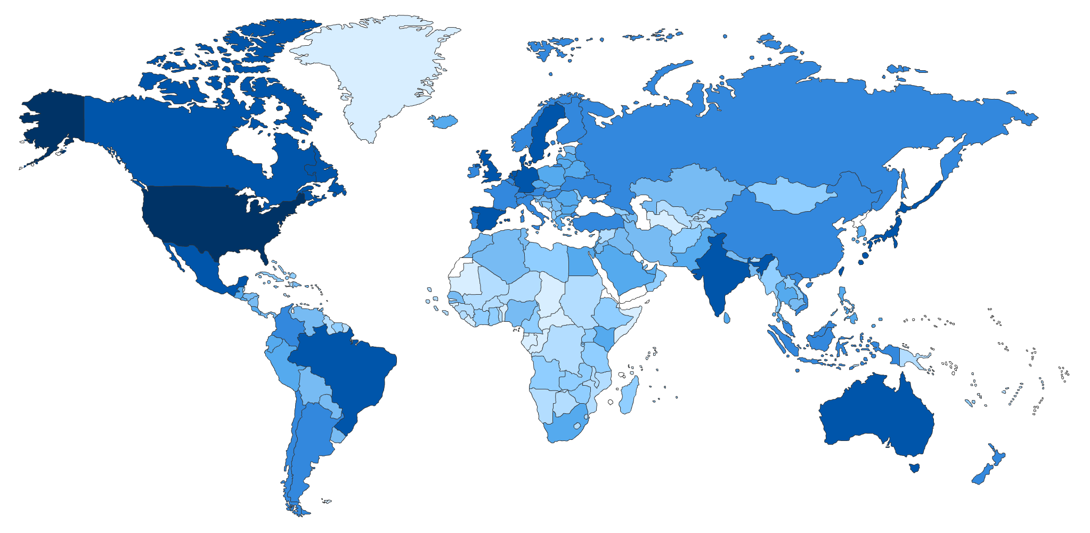








Global Scale and Enterprise Readiness
18,000 Cities globally access the service daily
190 Countries & territories
43 Languages
Global coverage
19 datacenters worldwide
National Clouds
US Government
China
Germany
Shaded areas show countries with Power BI usage. The darker the color the greater the number of users

Slide 21

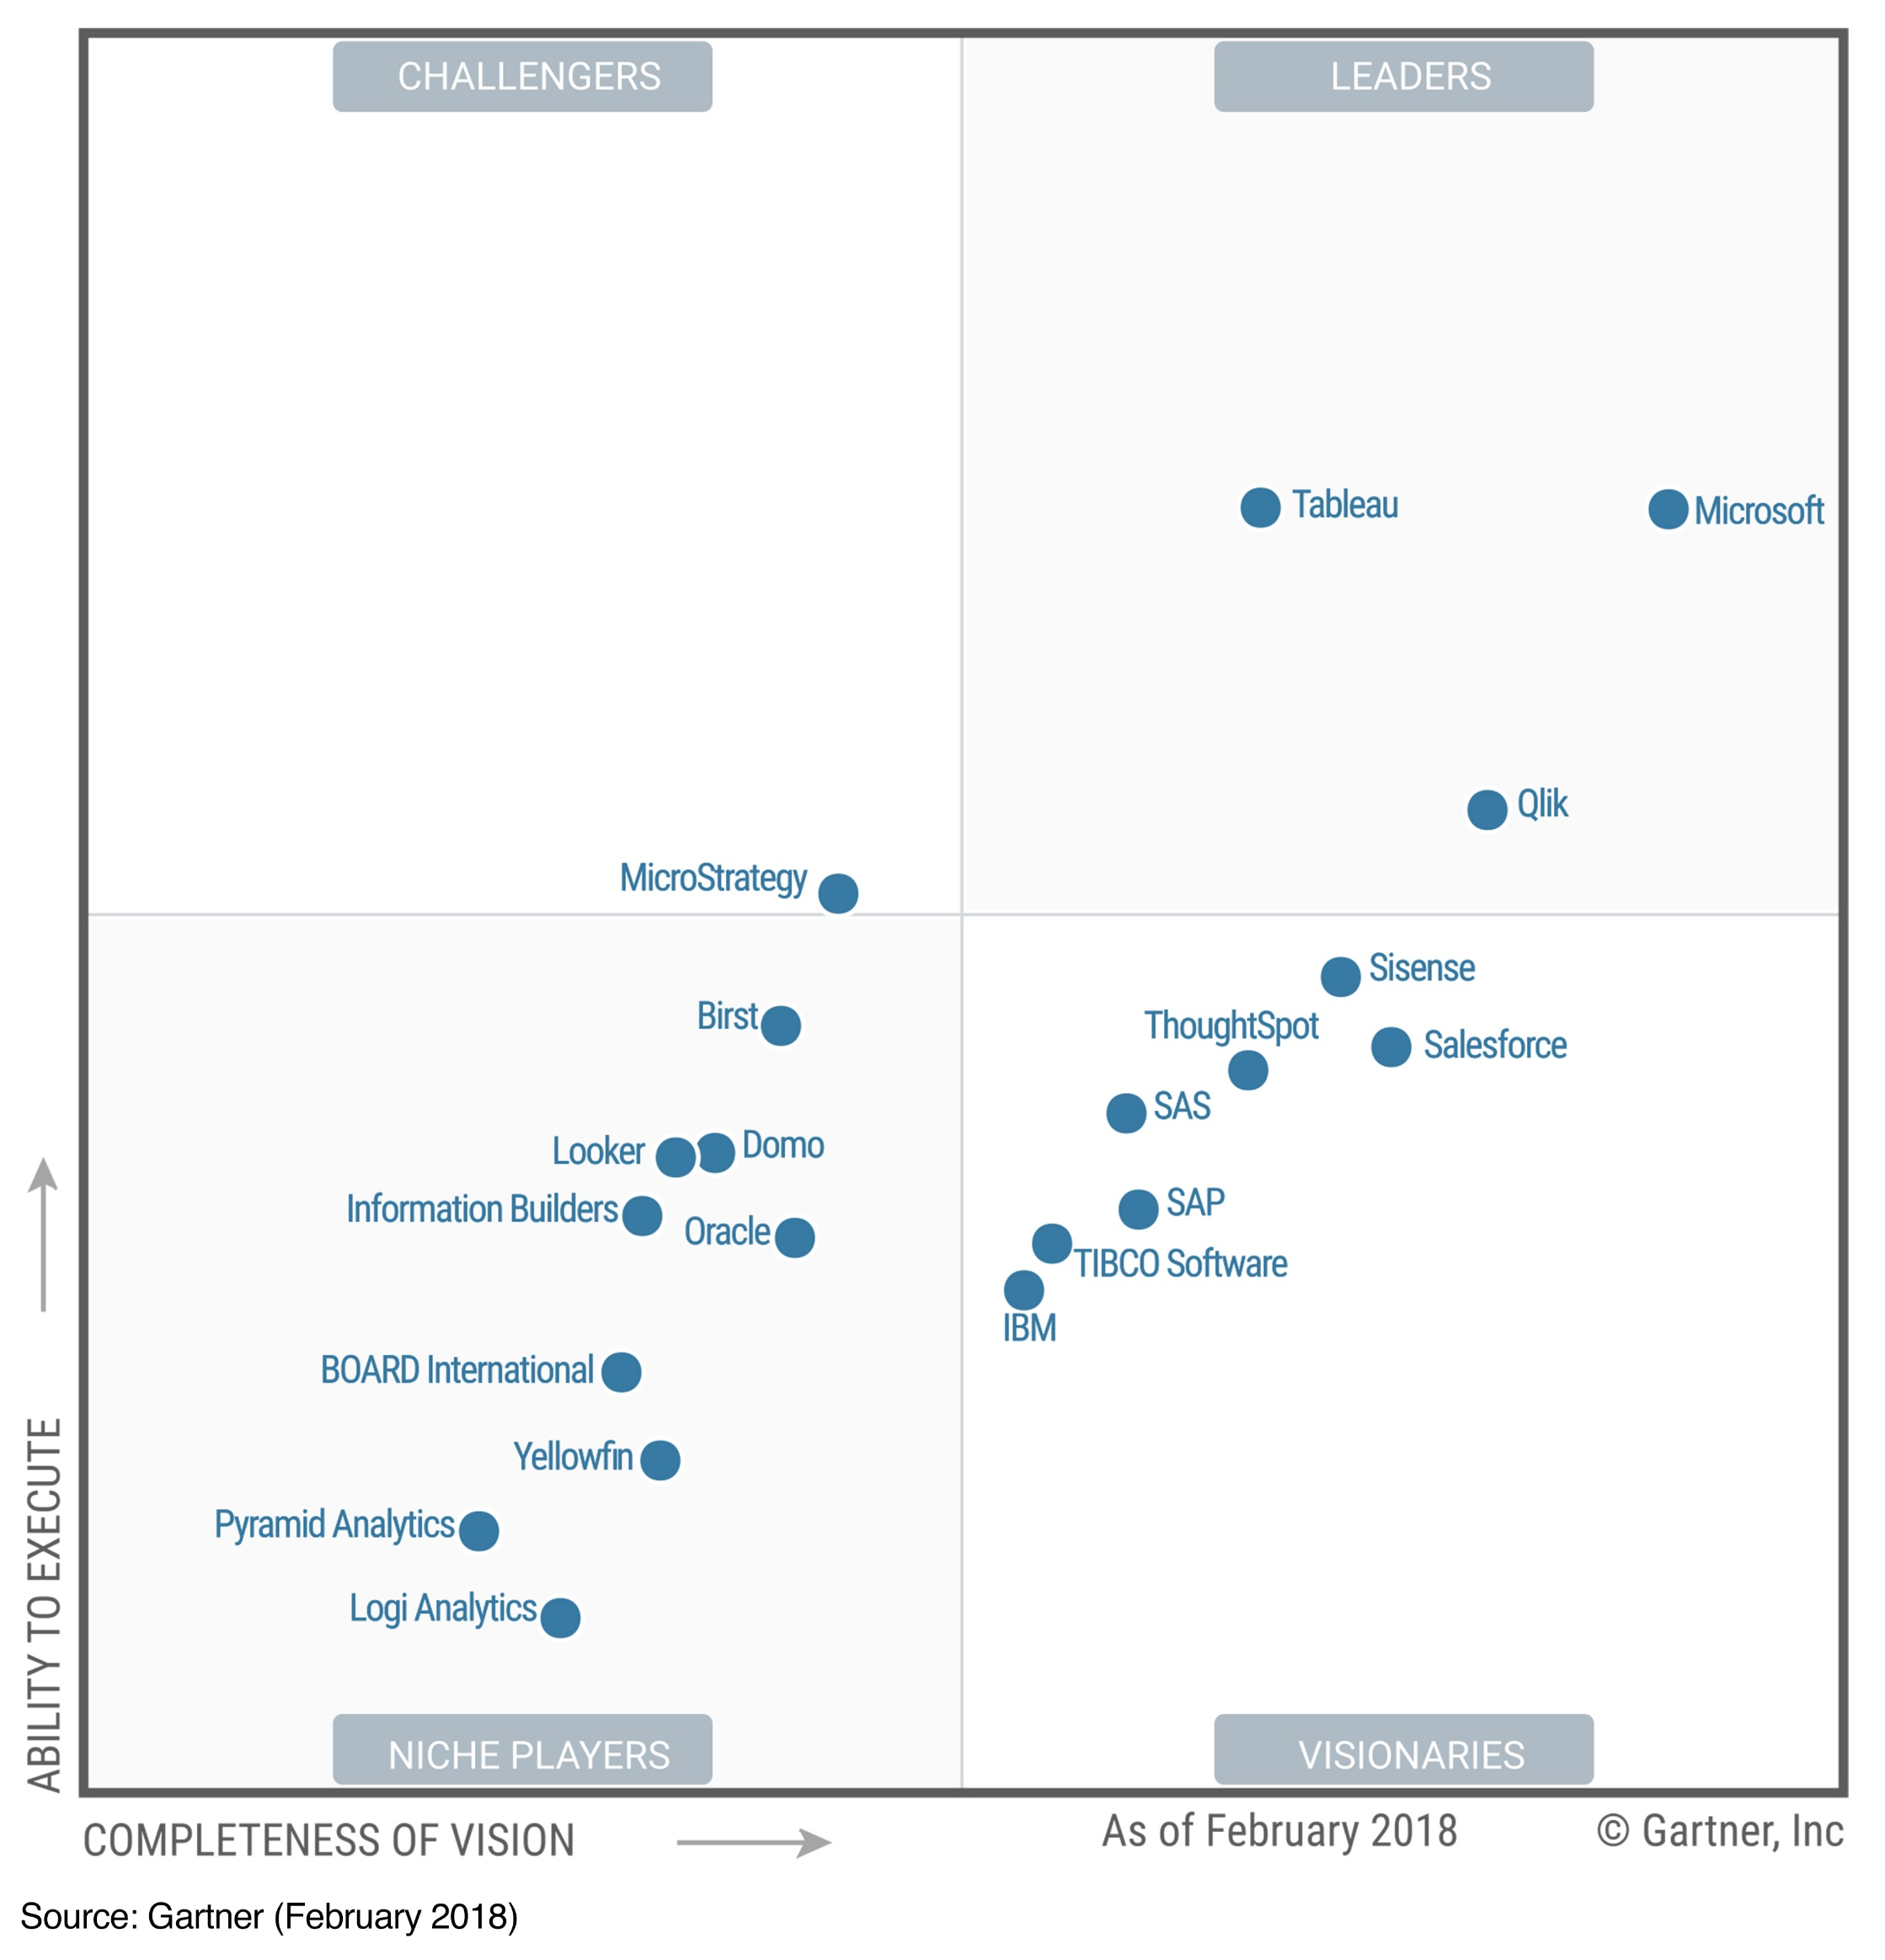
February 2018
A Leader in
Analytics & BI Platforms*
*Gartner “Magic Quadrant for Analytics and Business Intelligence Platforms,” by Cindi Howson, Rita L. Sallam, James Laurence Richardson, Joao Tapadinhas, Carlie J. Idoine, Alys Woodward, February 2018
The above graphics were published by Gartner, Inc. as part of a larger research document and should be evaluated in the context of the entire document. The Gartner document is available upon request from Microsoft. Gartner does not endorse any vendor, product or service depicted in its research publications, and does not advise technology users to select only those vendors with the highest ratings or other designation. Gartner research publications consist of the opinions of Gartner's research organization and should not be construed as statements of fact. Gartner disclaims all warranties, expressed or implied, with respect to this research, including any warranties of merchantability or fitness for a particular purpose.

Slide 22
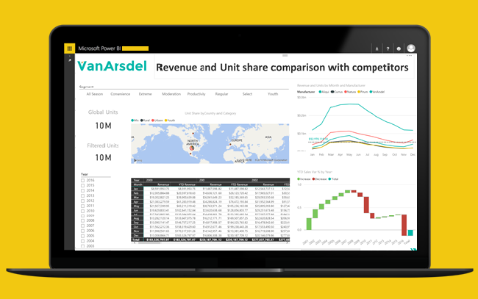
Power BI Desktop
Demo
Notes:
Demo script: https://onedrive.live.com/view.aspx?cid=8db176bf99f03f26&page=view&resid=8DB176BF99F03F26!11518&parId=8DB176BF99F03F26!11521&authkey=!ACOl6rkXp-UzZ6I&app=Word

Slide 23
Power BI Desktop
Hands-on learning

Slide 24
Lunch topics

Slide 25
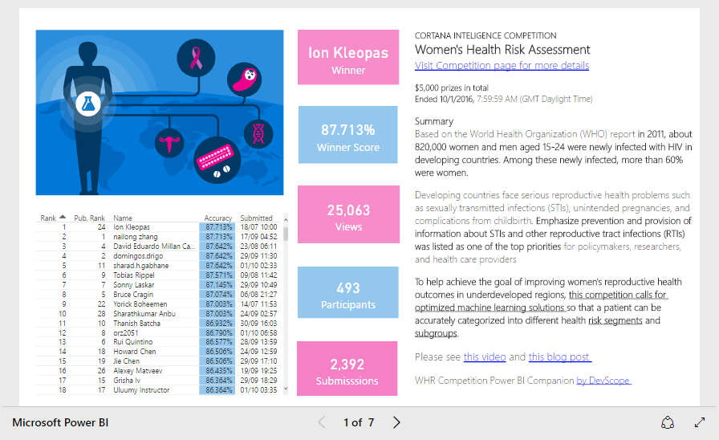
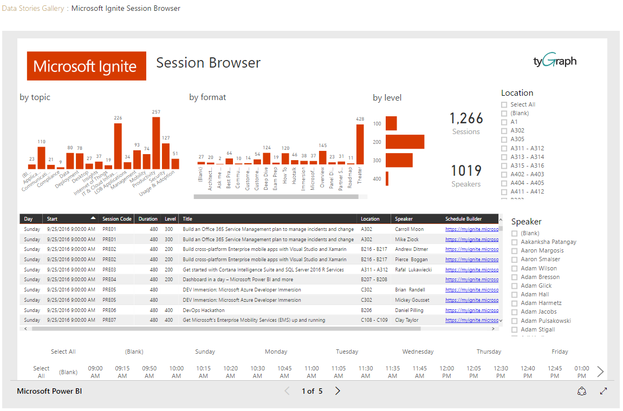
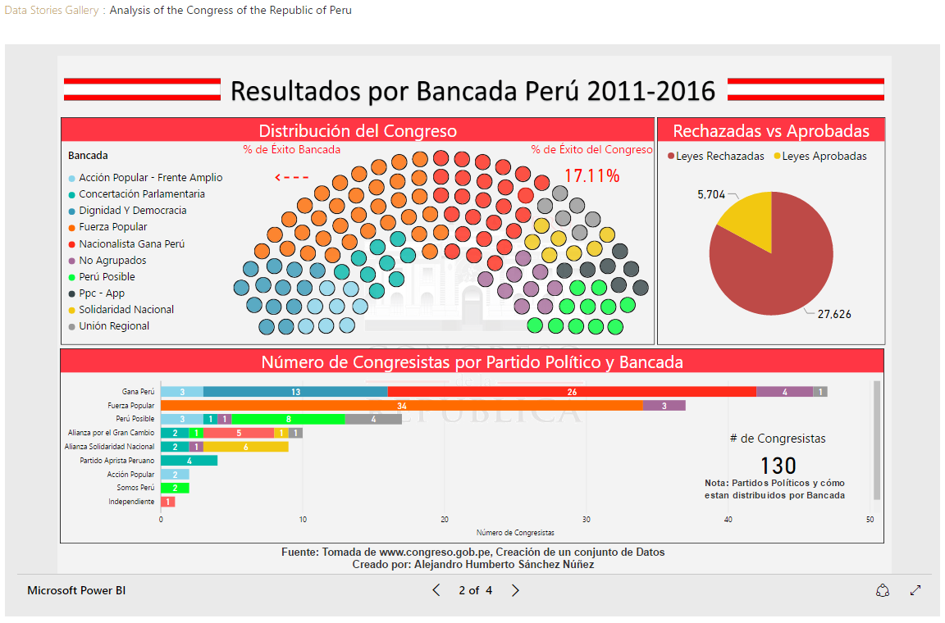
Explore and share your data stories
In the Data Stories Gallery

Slide 26
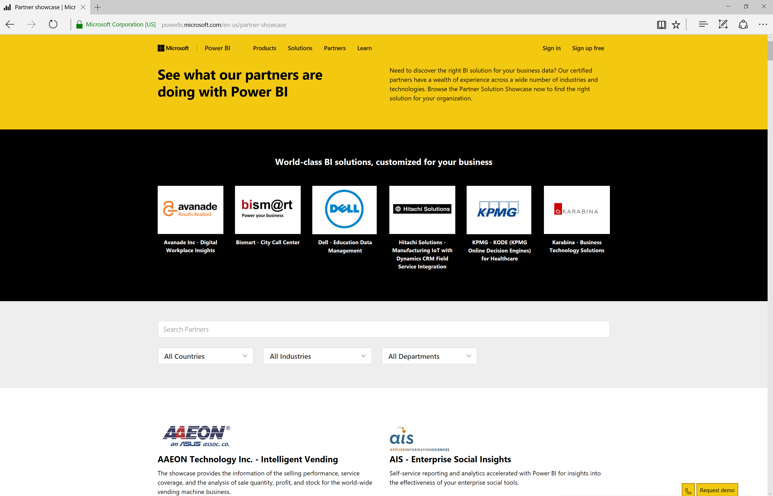
Find industry solutions in the Partner Showcase

Slide 27
Get Engaged with the Power BI User Group…
Network with Peers
More About Product
Ask Questions
See How Others Use the Product
Power BI User Groups (PUGs) provide resources, support and connections
Join your local PUG today! pbiusergroup.com

Slide 28
Connect with the Power BI community
What is the Power BI Community?
The Power BI Community is a place where customers and people who are passionate about Power BI can connect, learn, and discuss business intelligence with experts and peers
Who are members of the Power BI Community?
Registration on the Power BI Community is completely free and open to everyone. The community is made up of a mix of:
Microsoft Employees,
Product Engineers
IT Pros/Developers
Educators/students
Influencers and industry leaders
Business professionals and more!
What can I get out of the Power BI Community?
Connect with Power BI engineers and Microsoft employees.
Gain expert insight and feedback on a topic or provide suggestions on improving Power BI.
Member-exclusive events, such as the Power BI Ask Microsoft Anything (AMA) hour
Members-only resources on how to use Power BI.
Win prizes and earn exclusive perks by participating in Community Block Parties and Contests
How do I get started?
Register as a member the Power BI Community (https://community.powerbi.com/)
Edit and customize your profile.
Use the search bar to find and engage on relevant boards.
Popular options include:
Data Stories Gallery, Desktop, Service, Developer. Mobile Apps

Slide 29
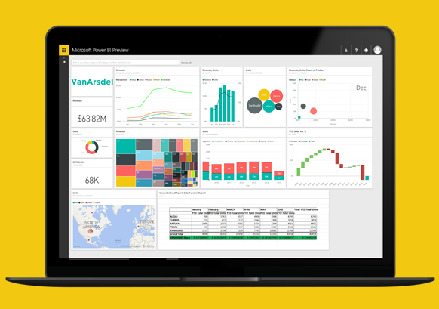
Power BI Service
Demo
Notes:
Demo script – present topics up to Excel reports: https://onedrive.live.com/view.aspx?cid=8db176bf99f03f26&page=view&resid=8DB176BF99F03F26!11516&parId=8DB176BF99F03F26!11521&authkey=!ACOl6rkXp-UzZ6I&app=Word

Slide 30
Power BI Service
Hands-on learning

Slide 31
Build reports and dashboards
On your own data

Slide 32
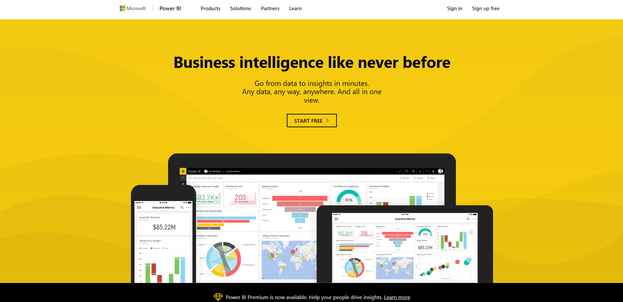
Get Started Now at PowerBI.com

Slide 33
Q&A

